Slide 1
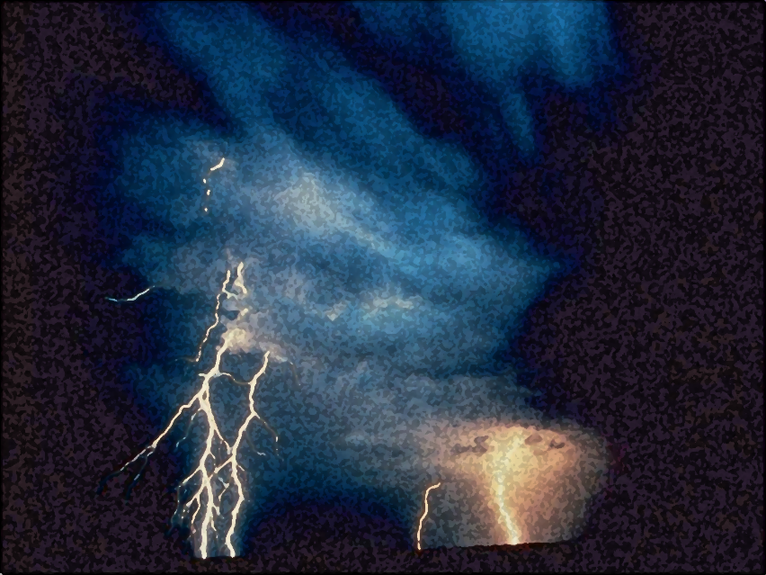
A Call to Servanthood
The Vision of Isaiah
Doom to Bloom

Slide 2
Theme and Purpose
How to become a useful, faithful and righteous servant of God.
A Call to Servanthood
How does sinful Israel become servant Israel?

Slide 3
Theme and Purpose
The entire book is an appeal to abandon human pride, to trust in the LORD, accept His lordship, and to experience all of life as it was originally meant to be - a reflection of God’s holy image and the role of a servant upon the earth.

Slide 4
Theme and Purpose
Isaiah introduces the problem: proud, arrogant sinful Israel is anything but the servant of God (1-5). The answer is God (6), the God who has the power (7-39) and the grace (40-66) to make the impossible, possible.

Slide 5
Broad Outline
1-5 – Introduction: The Present and
Future of God’s People
6 - A Call to Servanthood
7-39 - Whom shall We Trust? The Basis
for Servanthood
40-55 - The Vocation of Servanthood
56-66 - The Marks of Servanthood:
Divine Character

Slide 6
General Outline
1-6 – A Sinful Nation and a Holy God
7-39 – God is Trustworthy
40-48 – God’s Greatness and Love
49-55 – The Idea Servant
56-65 – The Living Out of Servanthood
66 – The Climax – God Glory

Slide 7
Distinctive Features
A Miniature Bible
66 Chapters
Divided into Two Sections
39 Chs. and 27 Chs.
Opens with the old heaven and earth and closes with a new heaven and earth.

Slide 8
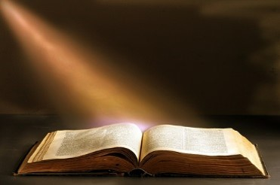
Distinctive Features
Isaiah is quoted some 80 times in the New Testament..
Quoted 60 times from chapter 53 alone.

Slide 9
The Vision of Isaiah
Introduction:
The Present and Future of God’s People
1:1 – 5:30

Slide 10
The Vision of Isaiah
Chapters 1-5 are a powerful, though general, statement of the hopes and realities of Judah’s situation. The section moves back and forth between the two themes of doom and deliverance.

Slide 11
The Vision of Isaiah
Chapter 1
Introduces the Introduction
“…in a very succinct way chapter 1 details Judah’s situation in God’s sight and calls them to Him” (p. 54)
“The Grand Arraignment”

Slide 12
Chapter 1
Sets the Stage for What Follows
Declares the inevitable destructive results of forsaking God
The foolishness of rote religion
The necessity of justice
The corruption of leadership
Through it all the possibility of redemption, return and restoration.

Slide 13
Listen, Learn, and Live
God’s Denunciation, Plea, and Promise
1:2-31

Slide 14
Listen, Learn, and Live
Denunciation – 1:2-9
God’s charge against Israel: She has forsaken the LORD and is as a result, broken and desolate.

Slide 15
Listen, Learn, and Live
Plea – 1:10-20
God’s plea for Israel to hear, receive instruction, and to take the only reasonable action: obedience and submission.

Slide 16
Listen, Learn, and Live
Promise – 1:21-30
God’s promise of judgment (death) for rebels and sinners, or redemption (life) for repentant ones.

Slide 17
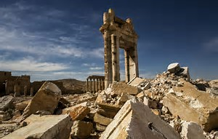
Listen, Learn, and Live
Israel’s Condition
1:2-9

Slide 18
Listen, Learn, and Live
“Hear, O heavens, and give ear, O earth! For the LORD has spoken: (1:2)

Slide 19
Listen, Learn, and Live
“I call heaven and earth as witnesses today against you, that I have set before you life and death, blessing and cursing;…” (Deut. 30:19)
The Covenant has been broken and its curses have been released.

Slide 20
Listen, Learn, and Live
What God’s people are doing is not just a matter of legality, but it is also an offense against nature, contrary to nature.

Slide 21
Listen, Learn, and Live
“I have nourished and brought up children, and they have rebelled against Me; The ox knows its owner and the donkey its master's crib; But Israel does not know, My people do not consider.” (1:2-3)

Slide 22
Listen, Learn, and Live
It is natural for a child to submit to a loving nourishing parent, but this is a shocking development: children rebellion against their own parents; an unnatural relationship that even animals know.

Slide 23
Listen, Learn, and Live
“When Israel was a child, I loved him, and out of Egypt I called My son.” (Hosea 11:1)
“…in the wilderness where you saw how the LORD your God carried you, as a man carries his son…” (Deut. 1:31)

Slide 24
Listen, Learn, and Live
“For what great nation is there that has God so near to it, as the LORD our God is to us, for whatever reason we may call upon Him? And what great nation is there that has such statutes and righteous judgments as are in all this law which I set before you.” (Deut. 4:7-8)

Slide 25
Listen, Learn, and Live
“For I am a Father to Israel, and Ephraim is My firstborn.” (Jer. 31:9)
Ezekiel 16:6-14

Slide 26
Listen, Learn, and Live
“Alas, sinful nation, a people laden with iniquity, a brood of evildoers, children who are corrupters! They have forsaken the LORD, they have turned away from the Holy One of Israel, they have turned away backward.” (1:4)

Slide 27
Listen, Learn, and Live
Verse 4-9 is a lament, a tone of sadness and grief. A powerful piece of poetry that describes Israel’s condition.
“Alas” = “Woe” – a cry of grief and doom, sorrow and death.

Slide 28
Listen, Learn, and Live
Israel’s Condition
“sinful, guilt-laden, evil, corrupt”
A series of karate chops:
short, sudden, and devastating
“They have forsaken the LORD”

Slide 29
Listen, Learn, and Live
“They have forsaken the LORD”
Judges 10:6-15
1 Samuel 12:6-10
2 Chronicles 21:8-11
2 Chronicles 24:23-24

Slide 30
Listen, Learn, and Live
A “nation” speaks of political and national identity.
“children” speaks of family identity.
They are the opposite of a family. Why?
They have forsaken the Lord

Slide 31
Listen, Learn, and Live
The nation, God’s children have turned their back on “the Holy One of Israel”
Israel’s God is “the Holy One”,
and there is no other God.
“holy” – “set apart in essence and
character”

Slide 32
Listen, Learn, and Live
In verses 5-6 we discover the destructive results of forsaking God, described using the metaphor of health.
The nation is desolate, naked and forsaken of God.

Slide 33
Listen, Learn, and Live
“Why should you be stricken again? You will revolt more and more. The whole head is sick, and the whole heart faints.” (1:5)

Slide 34
Listen, Learn, and Live
“From the sole of the foot even to the head, there is no soundness in it, but wounds and bruises and putrefying sores; They have not been closed or bound up, or soothed with ointment.” (1:6)

Slide 35
Listen, Learn, and Live
Israel’s condition is not merely a matter of disease, but she is also beaten and has suffered injuries received in battle: slash wounds, lacerations and bleeding wounds, the result of a confrontation with the Almighty.

Slide 36
Listen, Learn, and Live
But how can Israel bear the sufferings which have come upon her because of her rebellion?
The Ideal Servant will bear the sins of His people, “by His stripes we are healed.” (53:5)

Slide 37
Listen, Learn, and Live
As a result of abandoning God, and treating Him with indifference, the nation is desolate, naked and now forsaken of God.
“Because you have forsaken the LORD, He also has forsaken you.” (2 Chron. 24:20)

Slide 38
Listen, Learn, and Live
As a result of abandoning God, and treating Him with indifference, the nation is desolate, naked and now forsaken of God.
“You shall no longer be termed Forsaken, nor shall your land any more be termed Desolate.” (Isa. 62:4)

Slide 39
Listen, Learn, and Live
“Your country is desolate, your cities are burned with fire; Strangers devour your land in your presence; And it is desolate, as overthrown by strangers.” (1:7)

Slide 40
Listen, Learn, and Live
In verses 7-9, the prophet changes imagery, from a injured body to a desolation of a conquered land, by a major military invasion.
Desolation was nothing new
2 Chronicles 25:21-24

Slide 41
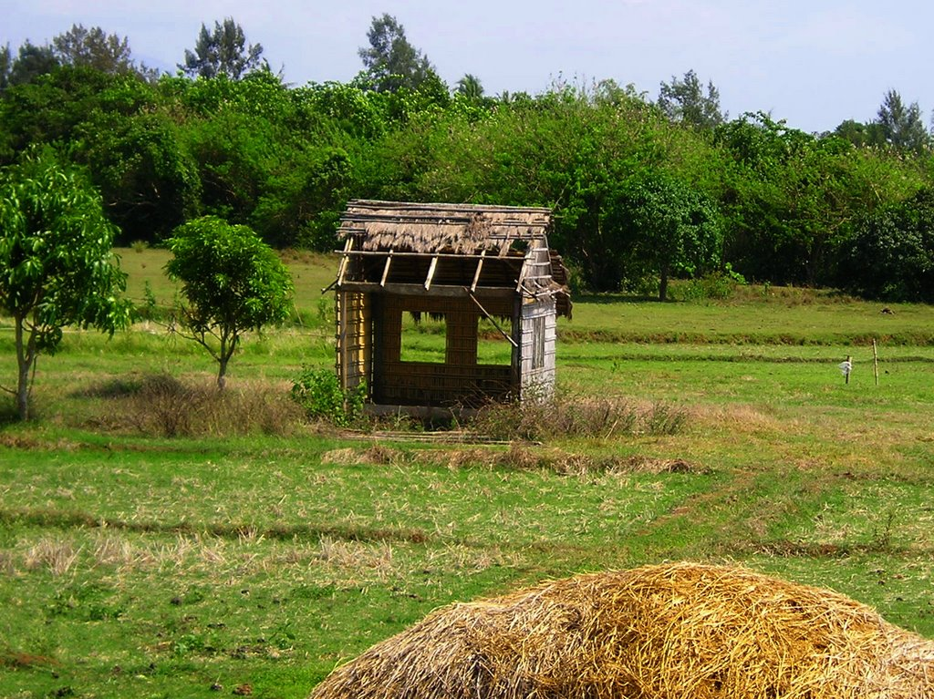
Listen, Learn, and Live
“So the daughter of Zion is left as a booth in a vineyard, as a hut in a garden of cucumbers, as a besieged city.” (1:8)
Small, but
not completely destroyed

Slide 42
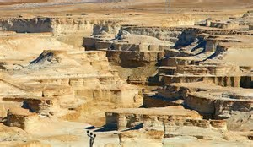
Listen, Learn, and Live
“Unless the LORD of hosts had left to us a very small remnant, we would have become like Sodom, we would have been made like Gomorrah.” (1:9)

Slide 43
Listen, Learn, and Live
God could have left his people like Sodom and Gomorrah – extinct, but He did not, He spared a very remnant – a survivor.
This was not an act of weakness, He is the LORD of host – a vast army.

Slide 44
Listen, Learn, and Live
God’s Desire: Justice, not Hypocritical Worship
1:10-20

Slide 45
Listen, Learn, and Live
In this section Isaiah lays out two ways of relating to God:

Slide 46
Listen, Learn, and Live
In this section Isaiah lays out two ways of relating to God:
through religious ceremonies (10-15)
through a life of ethical purity (16-17)
He closes with a challenge to choose between the two (18-20)

Slide 47
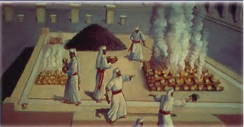
Listen, Learn, and Live
The Folly of Empty Cult
1:10-17

Slide 48
Listen, Learn, and Live
“Hear the word of the LORD, you rulers of Sodom; Give ear to the law of our God, you people of Gomorrah:” (1:10)
Spiritually speaking Israel is Sodom and Gomorrah.

Slide 49
Listen, Learn, and Live
“Hear the word of the LORD, you rulers of Sodom; Give ear to the law of our God, you people of Gomorrah:” (1:10)
God’s “tora” has to do with character, attitudes and relationships.

Slide 50
Listen, Learn, and Live
“To what purpose is the multitude of your sacrifices to Me?’ Says the LORD. ‘I have had enough of burnt offerings of rams and the fat of fed cattle. I do not delight in the blood of bulls, or of lambs or goats. When you come to appear before Me, who has required this from your hand, to trample My courts?” (11-12)

Slide 51
Listen, Learn, and Live
“Bring no more futile sacrifices; Incense is an abomination to Me. The New Moons, the Sabbaths, and the calling of assemblies -- I cannot endure iniquity and the sacred meeting. Your New Moons and your appointed feasts My soul hates; They are a trouble to Me, I am weary of bearing them.” (13-14)

Slide 52
Listen, Learn, and Live
“When you spread out your hands, I will hide My eyes from you; Even though you make many prayers, I will not hear. Your hands are full of blood.” (1:15)

Slide 53
Listen, Learn, and Live
The reader gets the impression of an endless round of activities all repeated continuously to no effect, sin was left unchallenged and unchanged, no wonder God had grown tired of it all.

Slide 54
Listen, Learn, and Live
After showing what God does not want Isaiah turns to show what he does desire, what pleasing Him, what gains His favor.

Slide 55
Listen, Learn, and Live
“Wash yourselves, make yourselves clean; Put away the evil of your doings from before My eyes. Cease to do evil, learn to do good; Seek justice, rebuke the oppressor; Defend the fatherless, plead for the widow.” (1:16-17)

Slide 56
Listen, Learn, and Live
“He has shown you, O man, what is good; And what does the LORD require of you but to do justly, to love mercy, and to walk humbly with your God?” (Micah 6:8)

Slide 57
Listen, Learn, and Live
The references here is to repentance, that begins with a change of attitude but also includes a change in behavior in order to avoid the wrath of God, the forsaking of God.

Slide 58
Listen, Learn, and Live
In light of Israel’s condition there is only one intelligent course of action –
Obedience and Submission

Slide 59
Listen, Learn, and Live
The Wisdom of Obedience
1:18-20

Slide 60
Listen, Learn, and Live
“Come now, and let us reason together,’ Says the LORD, ‘though your sins are like scarlet, they shall be as white as snow; though they are red like crimson, they shall be as wool.” (1:18)

Slide 61
Listen, Learn, and Live
“If you are willing and obedient, you shall eat the good of the land; But if you refuse and rebel, you shall be devoured by the sword’; For the mouth of the LORD has spoken.” (1:19-20)

Slide 62
Listen, Learn, and Live
It seems evident that God’s (fellowship) forgiveness is conditioned on a willing disposition and obedience to what he desires. This is what restores our personal (family) relationship.

Slide 63
Listen, Learn, and Live
These are the steps sinful Israel can become servant Israel.
These are the steps we need to take in order for us transform ourselves from sinners to servants.

